Slide 1
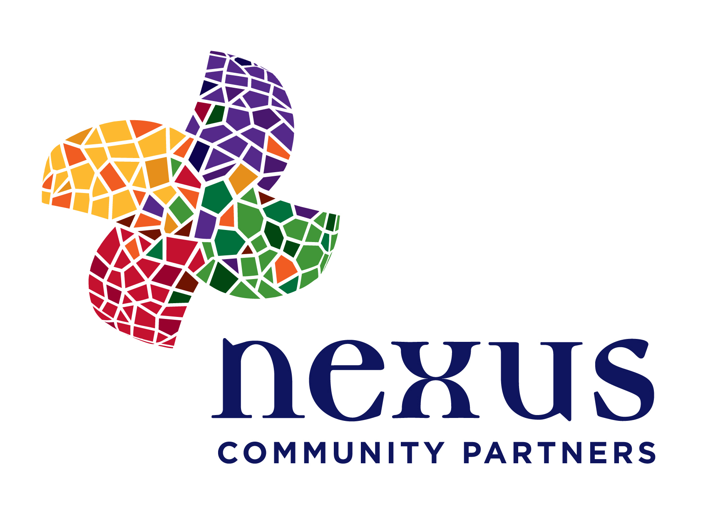
Nexus supports strong, equitable and just communities in which all residents are engaged, are recognized as leaders and have pathways to opportunities. The key to building more engaged and powerful communities of color lies in the interconnectedness between authorship, leadership and ownership.

Slide 2
How We Work
Community
Development
ne
us
Community
Philanthropy
Government/
Public Sector

Slide 3
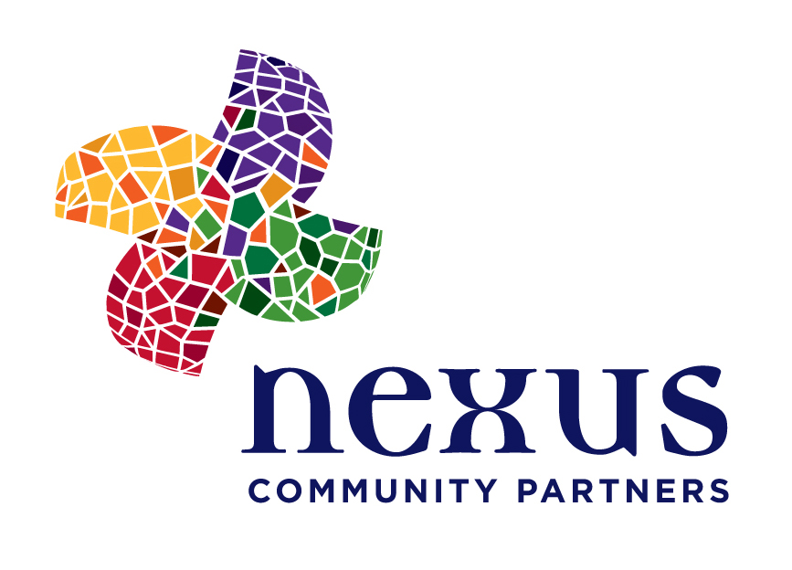
Authorship: Engaging Community
In a strong, equitable and just community, all members are engaged in and have authorship of their lives and their future. Nexus builds infrastructure for stronger community engagement learning and practice.
Leadership: Cultivating Power
In a strong, equitable and just community, all members are seen as leaders, are given ample opportunities to grow in their leadership, and are able to represent their communities in multiple spaces. Nexus invests in and cultivates leaders of color who are working to advance a broader agenda for equity. Ownership: Building Community Wealth
In a strong, equitable and just community, all members are afforded ample access points to generate wealth and to own the wealth they have helped to generate. Nexus challenges practitioners, community leaders and investors to use a community wealth-building framework to revitalize our communities.

